Slide 1
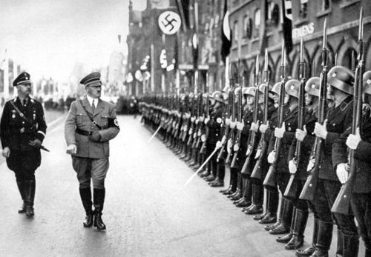
Year 11 History The Interwar Years 1918-1939
Learning intentions:
Apply key concepts to the study of the Interwar Years (sources, evidence, cause and effect, change and continuity, perspectives, significance, empathy, contestability).
Success criteria:
State one cause of WW2.
Briefly outline what the Versailles Treaty was and its repercussions for Germany.
Briefly outline the events of the Wall Street Crash and Great Depression.

Slide 2
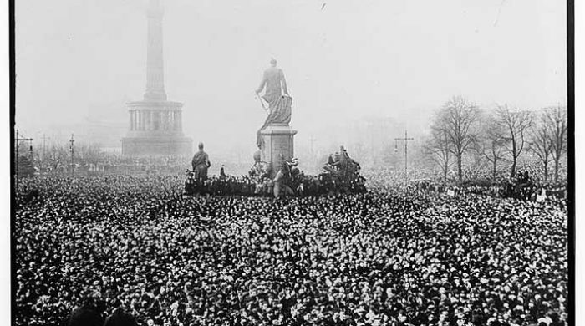
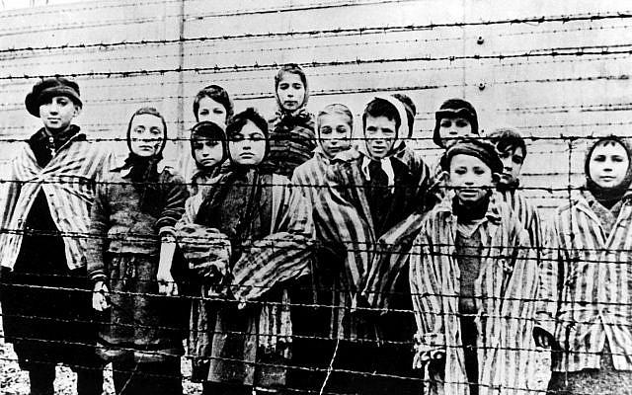
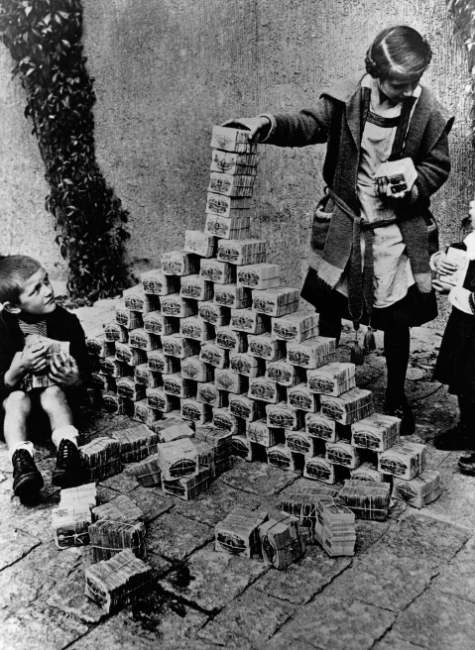
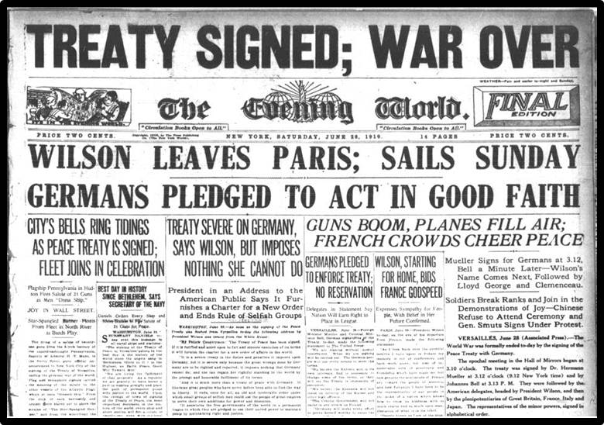
What do you remember from year 10 about the interwar period from 1919 to 1939?

Slide 3
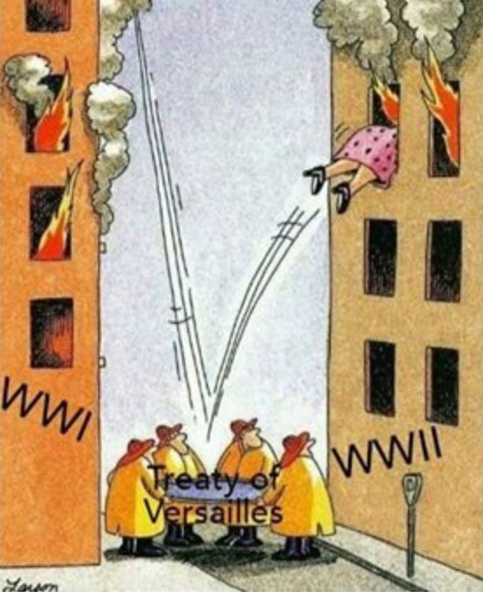
The Treaty of Versailles 1919
https://www.youtube.com/watch?v=vrYhLNQMRro&list=PLu2xst_eS6dqvm8HMr6xMw8trY7JNWBOS
https://www.youtube.com/watch?v=0jycVFL8CNM&index=2&list=PLu2xst_eS6dqvm8HMr6xMw8trY7JNWBOS

Slide 4
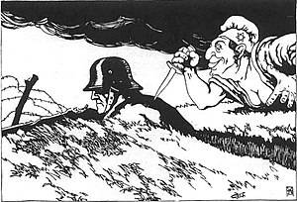
The Treaty of Versailles and the Dolchstosslegende
Many German’s bitterly resented the harsh terms of the Treaty of Versailles and its humiliating clause blaming Germany for World War One.
The ‘Stab in the Back’ myth (Dolchstosslegende) was created, promoting the idea that Germany had not been defeated but was betrayed by the ‘November criminals’, the Democratic Socialists who signed the Treaty.
Source 1

Slide 5
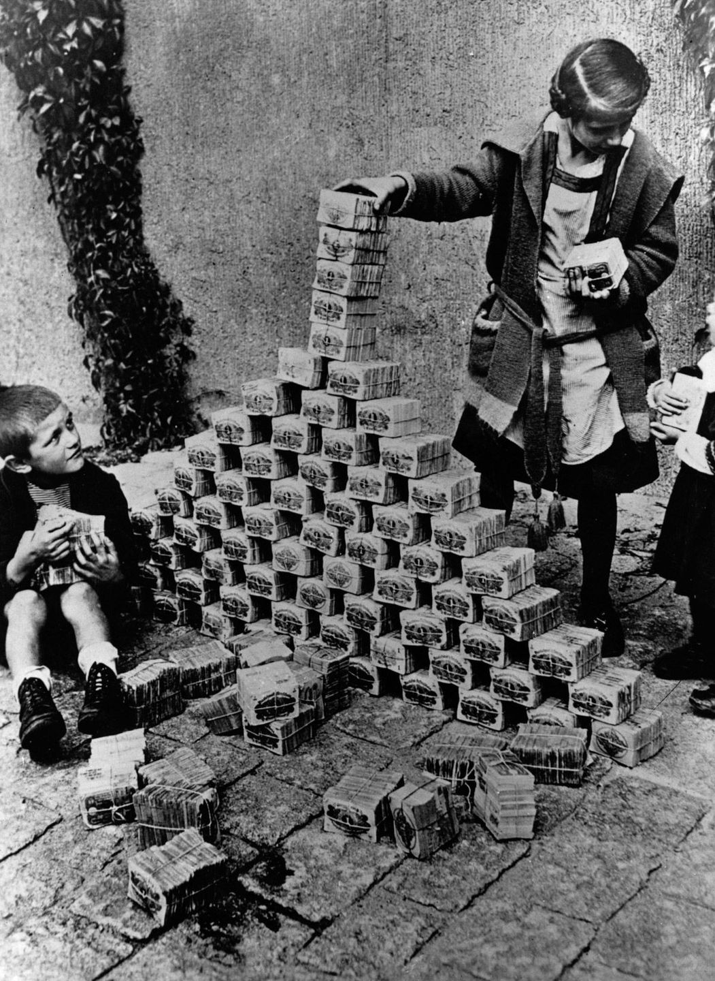
The Impact of the 1930s Great Depression
In the early 1920s Germany suffered hyperinflation as a result of printing money for reparations.
Germany was most severely affected by Great Depression.
By 1932 six million Germans were unemployed.
Source 2

Slide 6
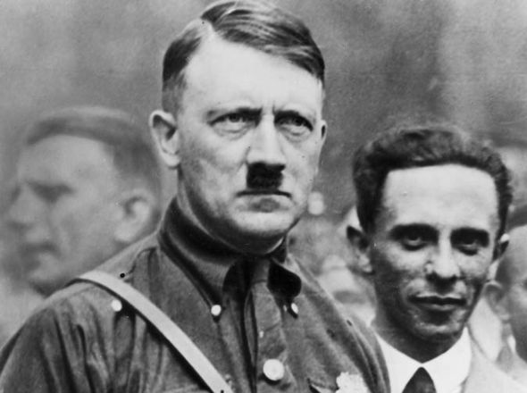
The Rise of the Nazis
After a failed attempt (sending Hitler to jail where he wrote Mein Kampf (My Struggle)) to seize power in 1923, Hitler focused on building support.
He built support through:
Propaganda (Joseph Goebbels)
Nuremburg rallies
Hitler Youth
Nazi ideology:
Only the strong survive
The hated communism was a Jewish ideology
The Germanic master race must defeat its racial
Germany must gain Lebensraum (living space) for its expanding population by taking land from non-Aryan races
The Fuhrerprinzip (leader principle) dictates that all opposition must be crushed and there must be total obedience to the leader.

Slide 7
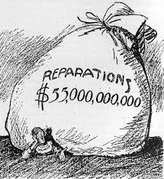
The fall of democratic government (Weimar)
Following WW1, German officials believed the ‘Big Three’ wouldn’t give them such harsh terms in the Treaty of Versailles if they had a democratic government. Therefore, the Weimar Republic was created.
The Nazi’s used the Great Depression and negative economic climate in Germany to gain popularity.
The Nazi Party gained votes in the Reichstag (government/parliament).
On 30th January 1933, President Hindenburg invited Hitler to become Chancellor.
Source 3

Slide 8
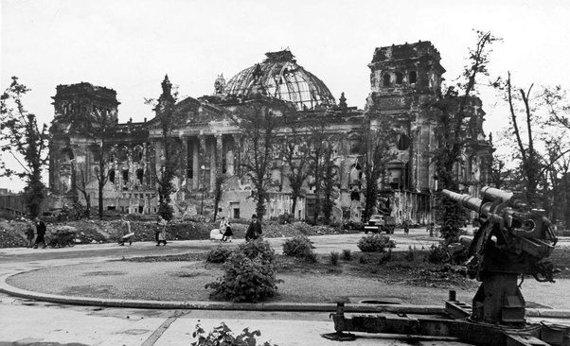
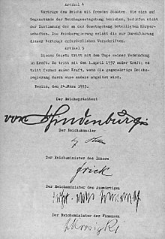
Consolidating Nazi Power
A month after Hitler became Chancellor, the Reichstag was severely damaged by fire.
The Nazi’s used this to stir fears of a Communist uprising.
Hitler persuaded President Hindenburg to issue a Decree for the Protection of People and State (The Reichstag Fire Decree) which abolished freedom of the press, speech and assembly.
The Nazi’s used this decree to restrict other political party campaigning.
March 1933 Reichstag elections, Nazi’s won.
23 March 1933 Enabling Act gave Hitler dictatorial powers.
Source 4

Slide 9
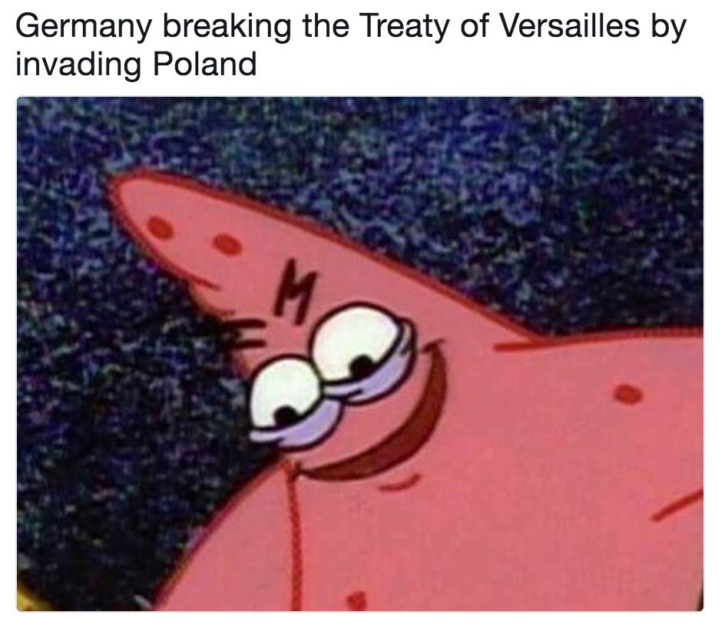
The Second World War begins…1939

Slide 10
Quick facts!
Polish Catholic midwife Stanisława Leszczyńska delivered 3,000 babies at the Auschwitz concentration camp during the Holocaust in occupied Poland.

Slide 11
Quick facts!
In World War II, British soldiers got a ration of three sheets of toilet paper a day. Americans got 22.

Slide 12
Quick facts!
Only 20% of the males born in the Soviet Union in 1923 survived the war.

Slide 13
Pop Question!
Who was Time Magazine’s Man of the Year in 1938?

Slide 14
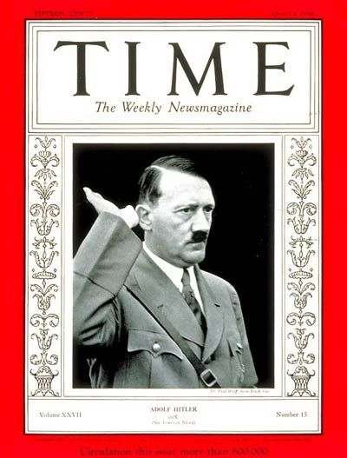

Slide 15
321RIQ: The Interwar Years (1918-1939)
3 recalls
State 3 facts you can recall (key dates, significant individuals, key events, economic/political/social relationships)
2 insights
Outline 2 insights you have (why is the information relevant? What is the significance of the events? How does this information relate to you? How does this information show cause and effect or continuity and change?)
1 question
(I do not understand why… How does this affect… What is the relevance of… How does this relate to… What would have happened if… )

